Slide 1
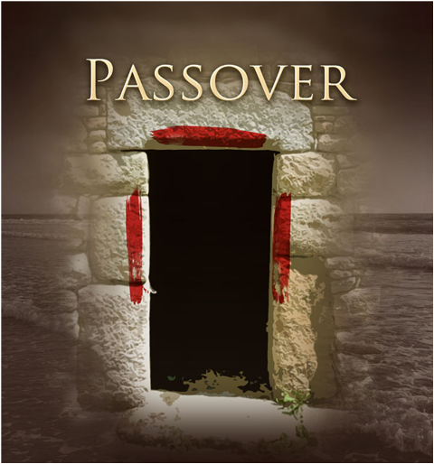
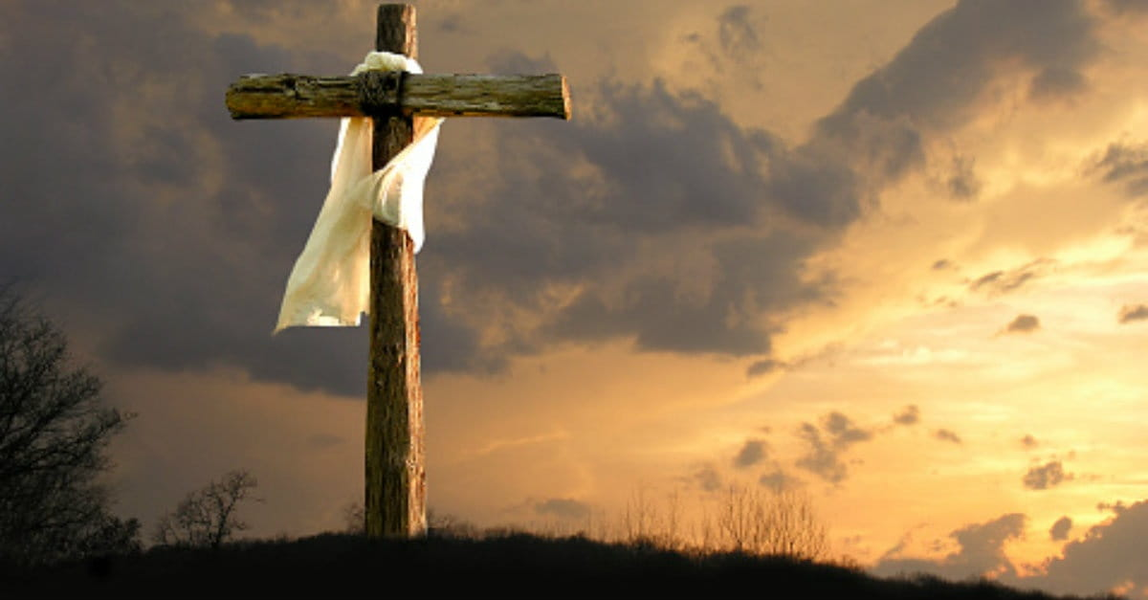
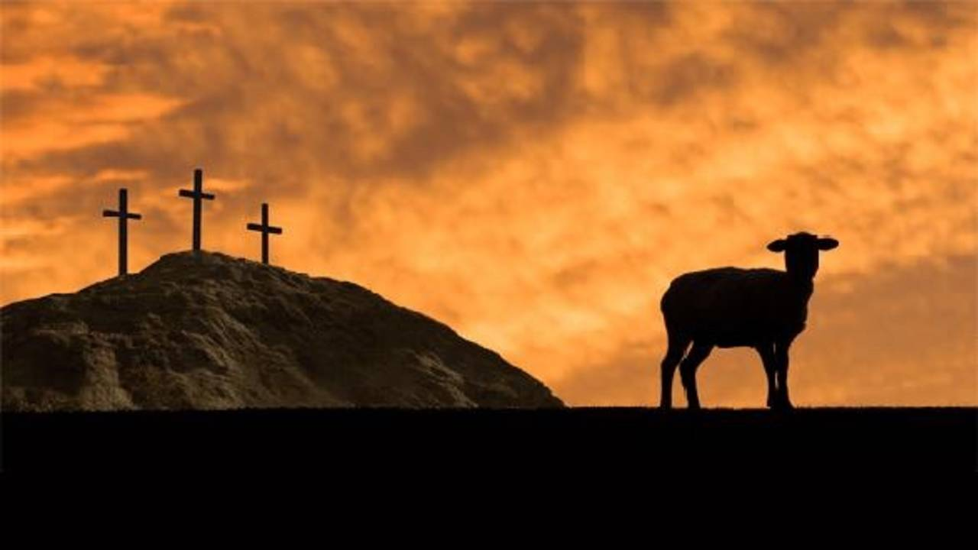
and the Cross
An Easter Sermon Series

Slide 2
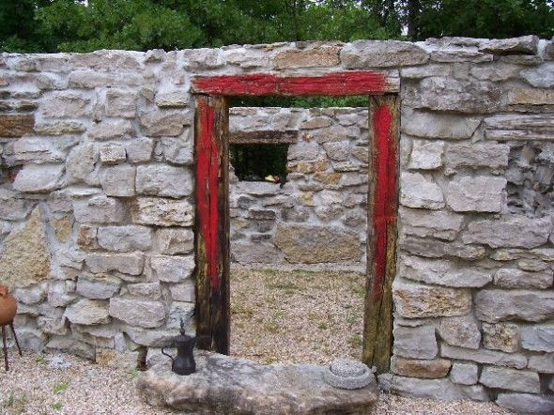
Exodus 12:1-7
While the Israelites were still in the land of Egypt, the LORD gave the following instructions to Moses and Aaron: 2 “From now on, this month will be the first month of the year for you. 3 Announce to the whole community of Israel that on the tenth day of this month each family must choose a lamb or a young goat for a sacrifice, one animal for each household. 4 If a family is too small to eat a whole animal, let them share with

Slide 3
Exodus 12:1-7
another family in the neighborhood. Divide the animal according to the size of each family and how much they can eat. 5 The animal you select must be a one-year-old male, either a sheep or a goat, with no defects. 6 “Take special care of this chosen animal until the evening of the fourteenth day of this first month. Then the whole assembly of the community of Israel must slaughter their lamb

Slide 4
Exodus 12:1-7
or young goat at twilight. 7 They are to take some of the blood and smear it on the sides and top of the doorframes of the houses where they eat the animal.

Slide 5
Why does Easter always fall on different dates for us?
Technically, it is celebrated at the same time every year
The difference is found in what calendar we use
Our calendar is a solar calendar
The Jewish calendar is a lunar calendar
Passover is celebrated on the exact same date on the lunar calendar every year.
Today is the 9th day of Nissan in the year 5,782

Slide 6
Choose a lamb!
One for each household
The Passover was for the whole nation
It was first for the individual
God has always been concerned about our personal relationship with Him
Yes, God was doing something to free Israel, but individual people had to decide if they were going to believe and follow
One without defect
It had to be perfect to cover their imperfections

Slide 7
Choose a lamb!
Slaughter him at twilight
Kill in such a way as to access its blood
Smear its blood on the sides and top of your doorframe
The sacrifice was for everyone inside of that house
The blood had to be applied to the doorframe for that house to be safe

Slide 8
Exodus 12:8-11
That same night they must roast the meat over a fire and eat it along with bitter salad greens and bread made without yeast.9 Do not eat any of the meat raw or boiled in water. The whole animal—including the head, legs, and internal organs—must be roasted over a fire.10 Do not leave any of it until the next morning. Burn whatever is not eaten before morning. 11 “These are your instructions for

Slide 9
Exodus 12:8-11
eating this meal: Be fully dressed, wear your sandals, and carry your walking stick in your hand. Eat the meal with urgency, for this is the LORD ’s Passover.

Slide 10
What were their instructions?
Roast it
A consuming fire had to be used
Eat it with bitter salad greens
The bitterness of slavery
Make bread without yeast
They would not have time for the bread to rise
It represented removing sin from their lives
Do not leave any of it
It had to be fully consumed by the flame

Slide 11
What were their instructions?
Be fully dressed
Dressed to leave the house
And be ready to leave quickly
Wear your sandals
Carry your walking sticks
Eat with urgency
“Hurry and alarm”

Slide 12
Exodus 12:12-13
On that night I will pass through the land of Egypt and strike down every firstborn son and firstborn male animal in the land of Egypt. I will execute judgment against all the gods of Egypt, for I am the LORD! 13 But the blood on your doorposts will serve as a sign, marking the houses where you are staying. When I see the blood, I will pass over you. This plague of death will not touch you when I strike the land of Egypt.

Slide 13
The blood will serve as a sign marking your place
When I see the blood I will Passover you
You will be safe
You will be saved
The plague of death will not touch you
Eternal death will not touch us when we have the blood of Jesus on our hearts and lives
This is showing us what Jesus will do on that Passover
It is still your choice

Slide 14
Exodus 12:21-27
Then Moses called all the elders of Israel together and said to them, “Go, pick out a lamb or young goat for each of your families, and slaughter the Passover animal. 22 Drain the blood into a basin. Then take a bundle of hyssop branches and dip it into the blood. Brush the hyssop across the top and sides of the doorframes of your houses. And no one may go out through the door until morning. 23 For the LORD will pass through the land to

Slide 15
Exodus 12:21-27
strike down the Egyptians. But when he sees the blood on the top and sides of the doorframe, the LORD will pass over your home. He will not permit his death angel to enter your house and strike you down. 24 “Remember, these instructions are a permanent law that you and your descendants must observe forever. 25 When you enter the land the LORD has promised to give you, you will continue to observe this ceremony.

Slide 16
Exodus 12:21-27
26 Then your children will ask, ‘What does this ceremony mean?’ 27 And you will reply, ‘It is the Passover sacrifice to the LORD, for he passed over the houses of the Israelites in Egypt. And though he struck the Egyptians, he spared our families.’” When Moses had finished speaking, all the people bowed down to the ground and worshiped.

Slide 17
Once you have applied the blood…
Go in, and do not leave
Once we discover His protection and love, why would we ever want to leave it?
Remember these instructions
We have to remember, because we have to pass them on
Never forget to worship
We have to be people who know how to thank God for what He does in our lives!

Slide 18
Exodus 12:28-30
So the people of Israel did just as the LORD had commanded through Moses and Aaron. 29 And that night at midnight, the LORD struck down all the firstborn sons in the land of Egypt, from the firstborn son of Pharaoh, who sat on his throne, to the firstborn son of the prisoner in the dungeon. Even the firstborn of their livestock were killed. 30 Pharaoh and all his officials and all the people of Egypt woke up during the night, and loud wailing was

Slide 19
Exodus 12:28-30
heard throughout the land of Egypt. There was not a single house where someone had not died.

Slide 20
When judgement came, those who had their faith in the blood were kept safe
The blood was the symbol of their faith
They believed in God and knew that His power would keep them safe
Do we believe the same thing this Easter?
Do we believe in the lifechanging power of Jesus?
Do we have faith that we will be kept safe?
Are we ready to travel?

