Slide 1
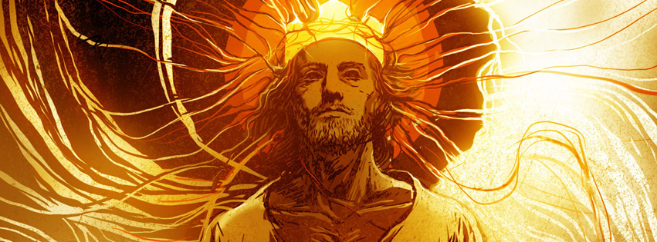
The Book of Revelation
A Sunday morning Sermon Series

Slide 2
Revelation 10:1-2
Then I saw another mighty angel coming down from heaven, surrounded by a cloud, with a rainbow over his head. His face shone like the sun, and his feet were like pillars of fire. 2 And in his hand was a small scroll that had been opened. He stood with his right foot on the sea and his left foot on the land.

Slide 3
Another mighty angel
This is not Jesus
Jesus is not an angel

Slide 4
Hebrews 1:4-13
This shows that the Son is far greater than the angels, just as the name God gave him is greater than their names. 5 For God never said to any angel what he said to Jesus: “You are my Son. Today I have become your Father. ” God also said, “I will be his Father, and he will be my Son.” 6 And when he brought his supreme Son into the world, God said, “Let all of God’s angels worship him.” 7 Regarding the angels, he says, “He sends his angels like the

Slide 5
Hebrews 1:4-13
winds, his servants like flames of fire.” 8 But to the Son he says, “Your throne, O God, endures forever and ever. You rule with a scepter of justice. 9 You love justice and hate evil. Therefore, O God, your God has anointed you, pouring out the oil of joy on you more than on anyone else.” 10 He also says to the Son, “In the beginning, Lord, you laid the foundation of the earth and made the heavens with your hands. 11 They will perish, but you remain forever.

Slide 6
Hebrews 1:4-13
They will wear out like old clothing. 12 You will fold them up like a cloak and discard them like old clothing. But you are always the same; you will live forever.” 13 And God never said to any of the angels, “Sit in the place of honor at my right hand until I humble your enemies, making them a footstool under your feet.”

Slide 7
Another mighty angel
This is not Jesus
Jesus is not an angel
Coming down from heaven
He was bring a message from God
Surrounded by a cloud
Coming with God’s power and might
A rainbow over his head
That this was part of God’s covenant with his creation

Slide 8
Another mighty angel
His face shone like the sun
He came from the presence of God
His feet were like pillars of fire
It symbolized the power of judgement that was coming from his message

Slide 9
He stood with a foot on the sea, and a foot on the land
It shows that his message will affect the whole world
What message?
The message from the open little scroll
This is not the other scroll
There are no seals on this scroll, it’s open
This is the message that the angel will be delivering

Slide 10
Revelation 10:3-4
And he gave a great shout like the roar of a lion. And when he shouted, the seven thunders answered. 4 When the seven thunders spoke, I was about to write. But I heard a voice from heaven saying, “Keep secret what the seven thunders said, and do not write it down.”

Slide 11
The shout of victory, and the next set of judgements
It shows us that the angel was proclaiming the victory that only comes from Jesus
The 7 thunders
We would say the 7 thunder judgements
We are not allowed to know what these 7 judgements are
They are to be kept secret
No one knows everything in advance
God planned it that way on purpose

Slide 12
Revelation 10:5-7
Then the angel I saw standing on the sea and on the land raised his right hand toward heaven. 6 He swore an oath in the name of the one who lives forever and ever, who created the heavens and everything in them, the earth and everything in it, and the sea and everything in it. He said, “There will be no more delay. 7 When the seventh angel blows his trumpet, God’s mysterious plan will be fulfilled. It will happen just as he announced it to his servants the prophets.”

Slide 13
The angel swore an oath
“A solemn usually formal calling upon God to witness to the truth of what one says”
It shows us who really has the power
The angel is not all powerful
This angel is just a messenger, but the one who gave him the message has the power and ability to make it happen
God is going to make it happen
The 7th trumpet will bring about the final set of judgements on the earth
What has to happen before Jesus will come to rule and reign on earth

Slide 14
Revelation 10:8-11
Then the voice from heaven spoke to me again: “Go and take the open scroll from the hand of the angel who is standing on the sea and on the land.” 9 So I went to the angel and told him to give me the small scroll. “Yes, take it and eat it,” he said. “It will be sweet as honey in your mouth, but it will turn sour in your stomach!” 10 So I took the small scroll from the hand of the angel, and I ate it! It was sweet in my mouth, but when I swallowed it,

Slide 15
Revelation 10:8-11
it turned sour in my stomach. 11 Then I was told, “You must prophesy again about many peoples, nations, languages, and kings.”

Slide 16
Why did John have to eat the scroll?
God was connecting John to the message
It was now a part of him
John’s role and leadership just changed
He is the one God chose to relay this message to the world
John was going to get off of the prison island and start this new phase of his ministry
How all of that was going to happen was just something that John was going to have to accept in faith

Slide 17
We will not know everything in this life, and we have to be okay with that
God allows this to happen to build up 3 things inside of us
Faith
The ability to believe that God will do what He said
Trust
The belief that God will take care of us, and always do things that will work out for our good
Hope
So that we will know that He will always be there for us

Slide 18
Just like John, we will have to explain what we know
We have to be connected to the message
It has to be alive inside of us
We have to be willing to take on our new role
Go into all the world and proclaim the good news…
We have to discover what role God wants us to play
He wants to use you, have you prayed and asked God what your role is?

