Slide 1
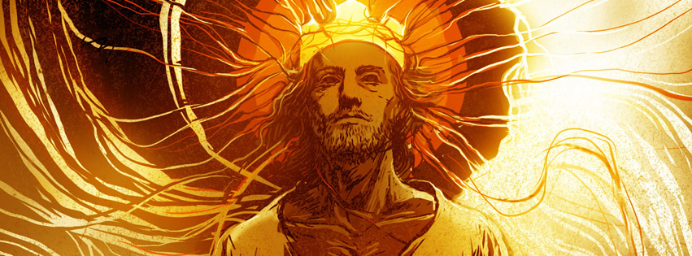
The Book of Revelation
A Sunday morning Sermon Series

Slide 2
Revelation 1:7
Look! He comes with the clouds of heaven. And everyone will see him— even those who pierced him. And all the nations of the world will mourn for him. Yes! Amen!

Slide 3
He comes with the clouds of heaven
Clouds in the Old Testament were a symbol of God’s presence and His glory
Pillar of cloud that lead Israel out of Egypt
The cloud over Mt. Sinai
The cloud that covered the Tabernacle when God spoke with Moses
The cloud that covered the Temple when it was dedicated.
Ezekiel’s vision of God that started in a cloud.

Slide 4
He comes with the clouds of heaven
The difference between Jesus coming, and Jesus coming.
The physical return of Jesus to earth where He will rule and reign for 1,000 years
The return in the clouds to come and get His bride, the church
This is a reference to Jesus returning for His church
We will be in His presence forever!

Slide 5
Every Eye will see Him
Everyone on earth will see this event happen
It will happen in such a way that everyone everywhere will see this event happening
Either from the clouds or from the earth!
There will be mourning
This event will affect two groups of people that will have two very different reactions
Before we get there, we first have to establish what we are talking about, and to do that we have to begin with what Jesus said!

Slide 6
Mark 14:62
Jesus said, “I AM . And you will see the Son of Man seated in the place of power at God’s right hand and coming on the clouds of heaven. ”

Slide 7
1 Thessalonians 4:16-17
For the Lord himself will come down from heaven with a commanding shout, with the voice of the archangel, and with the trumpet call of God. First, the believers who have died will rise from their graves. 17 Then, together with them, we who are still alive and remain on the earth will be caught up in the clouds to meet the Lord in the air. Then we will be with the Lord forever.

Slide 8
The Rapture of the church
The next event in church history
This has to take place before everything else happens!
Two things happen at almost the same time
First, the believers already in Heaven will get their new bodies.
Second, we who are earth will be caught up in the clouds to meet Jesus!
We get our new bodies on the way up!
We get to be with Jesus forever
Forever is forever!

Slide 9
Matthew 24:36-44
“However, no one knows the day or hour when these things will happen, not even the angels in heaven or the Son himself. Only the Father knows. 37 “When the Son of Man returns, it will be like it was in Noah’s day. 38 In those days before the flood, the people were enjoying banquets and parties and weddings right up to the time Noah entered his boat. 39 People didn’t realize what was going to happen until the flood came and swept them all away. That is the way it will be when the Son of Man comes. 40 “Two men will be working

Slide 10
Matthew 24:36-44
together in the field; one will be taken, the other left. 41 Two women will be grinding flour at the mill; one will be taken, the other left. 42 “So you, too, must keep watch! For you don’t know what day your Lord is coming. 43 Understand this: If a homeowner knew exactly when a burglar was coming, he would keep watch and not permit his house to be broken into. 44 You also must be ready all the time, for the Son of Man will come when least expected.

Slide 11
We do not know when this event will happen
Only the Father knows
It means that it will take place in His perfect timing for it to happen!
it’s nothing that we can speed up or slow down.
We are now told that it will happen “shortly”

Slide 12
Remember this will effect 2 groups of people.
Those who are “taken”
It happens in an instant – no time to prepare
“He will come when least expected!”
They are removed from this earth and enter the presence of Jesus!
Those who are “left”
They will be the ones who will go through what happens after Chapter 4 in the book of Revelation – they experience God’s wrath.

Slide 13
It will be like it was before the flood
Life will continue until that moment!
Life will be normal, with all its normal events.
The Godly will be kept safe from that judgement!
Noah didn’t feel one rain drop, He was safe on the Ark, and God shut the door to keep him safe!
Those who rejected God will face the judgement
That is what happened with the flood, and Jesus said it will be like this.

Slide 14
Are you ready for Jesus to return on the clouds?
You either are or you are not.
It happens to fast to get ready for it!
You have to live ready!
If you feel any fear or hesitancy that’s the Holy Spirit talking to you today.
God is reminding us today to be ready
Are you?

Slide 15
Revelation 1:8
“I am the Alpha and the Omega—the beginning and the end,” says the Lord God. “I am the one who is, who always was, and who is still to come—the Almighty One.”

Slide 16
This is our conformation that we will indeed be with Him forever!
This has been His plan from the very beginning!
He did everything to make this a reality for us!
He is the Almighty!
He has the ability to save those who believe
He has the ability to judge those who do not
We can know that everything that Jesus said will happen

