Slide 1
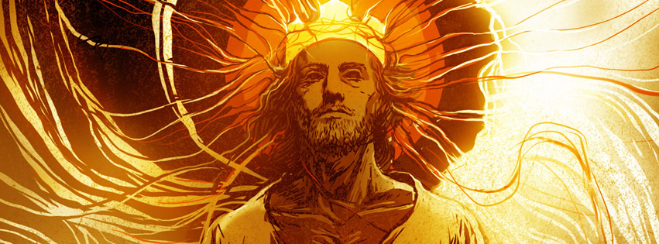
The Book of Revelation
A Sunday morning Sermon Series

Slide 2
Revelation 1:3
God blesses the one who reads the words of this prophecy to the church, and he blesses all who listen to its message and obey what it says, for the time is near.

Slide 3
God blesses those who…
Read what is coming
God expects us to know what His plan is, so that we can be ready when we see it coming!
Who listen to what it says, and change
It’s not enough to know what it says; we have to let the message change us!
Obey what it says
Do we actually love God enough to do what He says?

Slide 4
The time is near
It is almost here
And if these things are going to start happening, everything that follows in this book shows us what we should be looking for!
Do you realize how close everything is?
God wants us to be ready, not afraid!
Nothing that happens in this book should bring fear to those who are doing what God said!

Slide 5
Revelation 1:4-5
This letter is from John to the seven churches in the province of Asia. Grace and peace to you from the one who is, who always was, and who is still to come; from the sevenfold Spirit before his throne; 5 and from Jesus Christ. He is the faithful witness to these things, the first to rise from the dead, and the ruler of all the kings of the world. All glory to him who loves us and has freed us from our sins by shedding his blood for us.

Slide 6
This is a letter to the churches…
As a letter it has a meaning for the original churches mentioned
This is what Jesus has to say to each church
A letter to 7 churches
7 is a number you will see a lot of in the book of Revelation
7 is a number that when God uses it, it represents completeness or whole.

Slide 7
This is a letter to the churches…
It wasn’t just a message to those 7 churches, but to all the churches of that time!
Since it meant complete or whole, it is still a message to us today!
We are to let its message make a difference in our lives!
We should respond to its message and truth!

Slide 8
Jesus is going to give us this message
It’s coming to us from the Holy Spirit
He is the 7 fold Spirit.
It means that He is the one bringing this message to our hearts from Jesus himself.
Jesus has the power to make all of this happen
He was faithful
He was the first to rise from the dead
He is the ruler of all the kings

Slide 9
Jesus is going to give us this message
This happened because He shed His blood for our sins
We are free!
We are more than free!

Slide 10
Revelation 1:6
He has made us a Kingdom of priests for God his Father. All glory and power to him forever and ever! Amen.

Slide 11
Jesus has made us a Kingdom of priests
Jesus has made us
He has made us into something new
He has made us into a kingdom
Literally means – a realm in which a king sovereignly reigns
A place in the believer’s hearts!
Because Jesus lives inside of us, we become something different than we used to be

Slide 12
Jesus has made us a Kingdom of priests
He has made us priests
Someone who offers sacrifices to God
People who served the worship of God
We are truly changed because of Jesus in our hearts
All who have Jesus in their hearts and lives have become His Kingdom on this earth

Slide 13
Jesus has made us a Kingdom of priests
What is a priest supposed to do?
We are now able to serve God and help other people experience Him!
We have a different access to God
We live dedicated or Holy lives
We intercede or pray for the needs of people
We teach and train people to teach and defend God’s word

Slide 14
How well are we doing our new job?
Have you allowed God to change you?
Are you still the same person you were before you found Jesus?
Does Jesus have access to every part of your heart?
Is there any part of your life that you are holding back?
Are we living Holy lives?
Not just saying that we do, is there proof of it in our lives?

Slide 15
How well are we doing our new job?
Are we praying for the needs of people?
Are we teaching others?
We have to replicate what God has done in us in the life of someone else!
Who are you teaching today?
Are we defending God’s Word?

