Slide 1
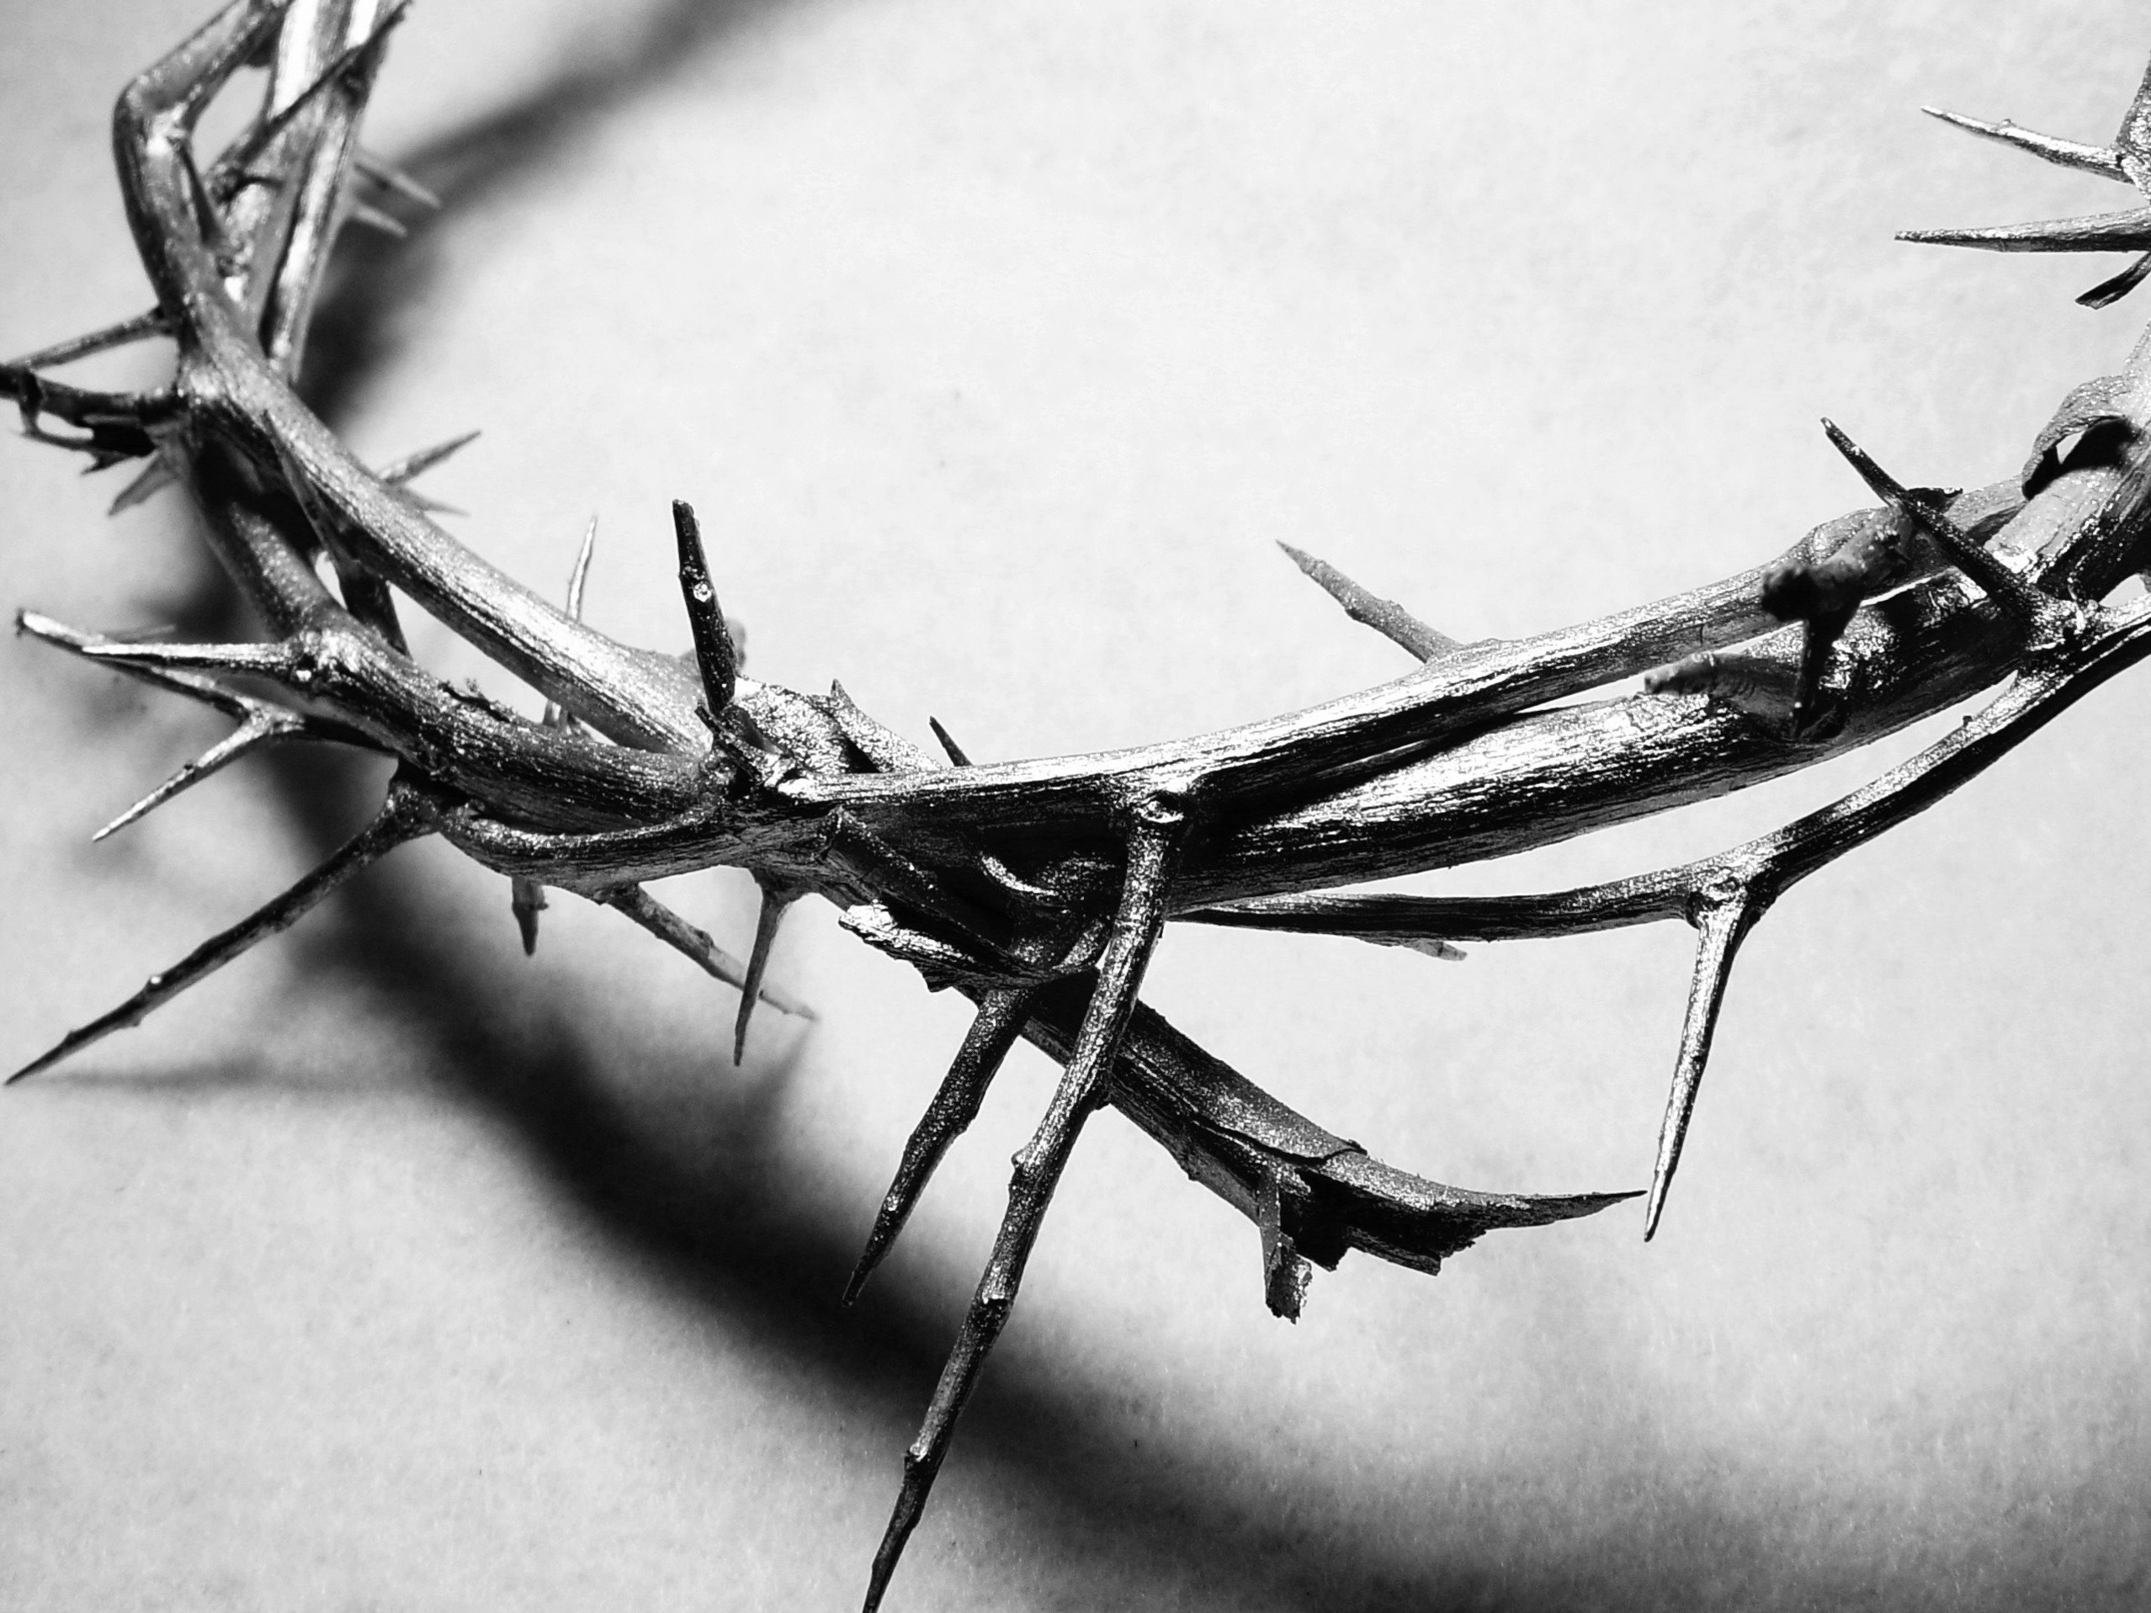
The Last Year

Slide 2
John 15:1-2
I am the true grapevine, and my Father is the gardener. 2 He cuts off every branch of mine that doesn’t produce fruit, and he prunes the branches that do bear fruit so they will produce even more.

Slide 3
I am the true grapevine
The vine was a symbol of Israel in the O.T.
It wasn’t always seen as something good
Jeremiah 2:21 -But I was the one who planted you, choosing a vine of the purest stock—the very best. How did you grow into this corrupt wild vine?
By calling Himself the true vine Jesus is saying that He is the way to fix what has been lacking

Slide 4
My Father is the Gardner
God the Father is the one who plants and tends the vine
He takes care of the vine
He cuts off every branch that doesn’t produce fruit
He prunes the branches that bear fruit

Slide 5
We are the branches, and one of 2 things will happen to us!
If we bear fruit, we will be pruned!
In pruning us, God will do things that will help us grow.
Those things that help us grow might be painful and hard to experience.
If we do not bear fruit, we will be cut off!
If we are not seeing any spiritual fruit in our lives, we can’t just think that everything is going to be okay.
If we refuse to obey, God has no choice but to take this step.

Slide 6
John 15:3-5
You have already been pruned and purified by the message I have given you. 4 Remain in me, and I will remain in you. For a branch cannot produce fruit if it is severed from the vine, and you cannot be fruitful unless you remain in me. 5 “Yes, I am the vine; you are the branches. Those who remain in me, and I in them, will produce much fruit. For apart from me you can do nothing.

Slide 7
Remain in me, and I will remain in you
A branch by itself will die, it has to be connected to the vine to grow!
You cannot be fruitful unless you remain in me!
The only way we will produce fruit is to be attached to the vine!
Apart from me you can do nothing!

Slide 8
John 15:6
Anyone who does not remain in me is thrown away like a useless branch and withers. Such branches are gathered into a pile to be burned.

Slide 9
Anyone who doesn’t remain is thrown away and burned!
We have a choice
We can see what choice we have made by seeing how much fruit we really have
Remember the warning; branches that do not produce fruit are cut off and thrown into the fire!

Slide 10
John 15:7-8
But if you remain in me and my words remain in you, you may ask for anything you want, and it will be granted! 8 When you produce much fruit, you are my true disciples. This brings great glory to my Father.

Slide 11
When you produce much fruit, you are my true disciple!
If we believe, we will do greater things
If we are obedient we will remain attached to the vine
If we stay attached to the vine, we will produce fruit.
If we produce fruit, God will prune us so that we will produce more fruit

