Slide 1
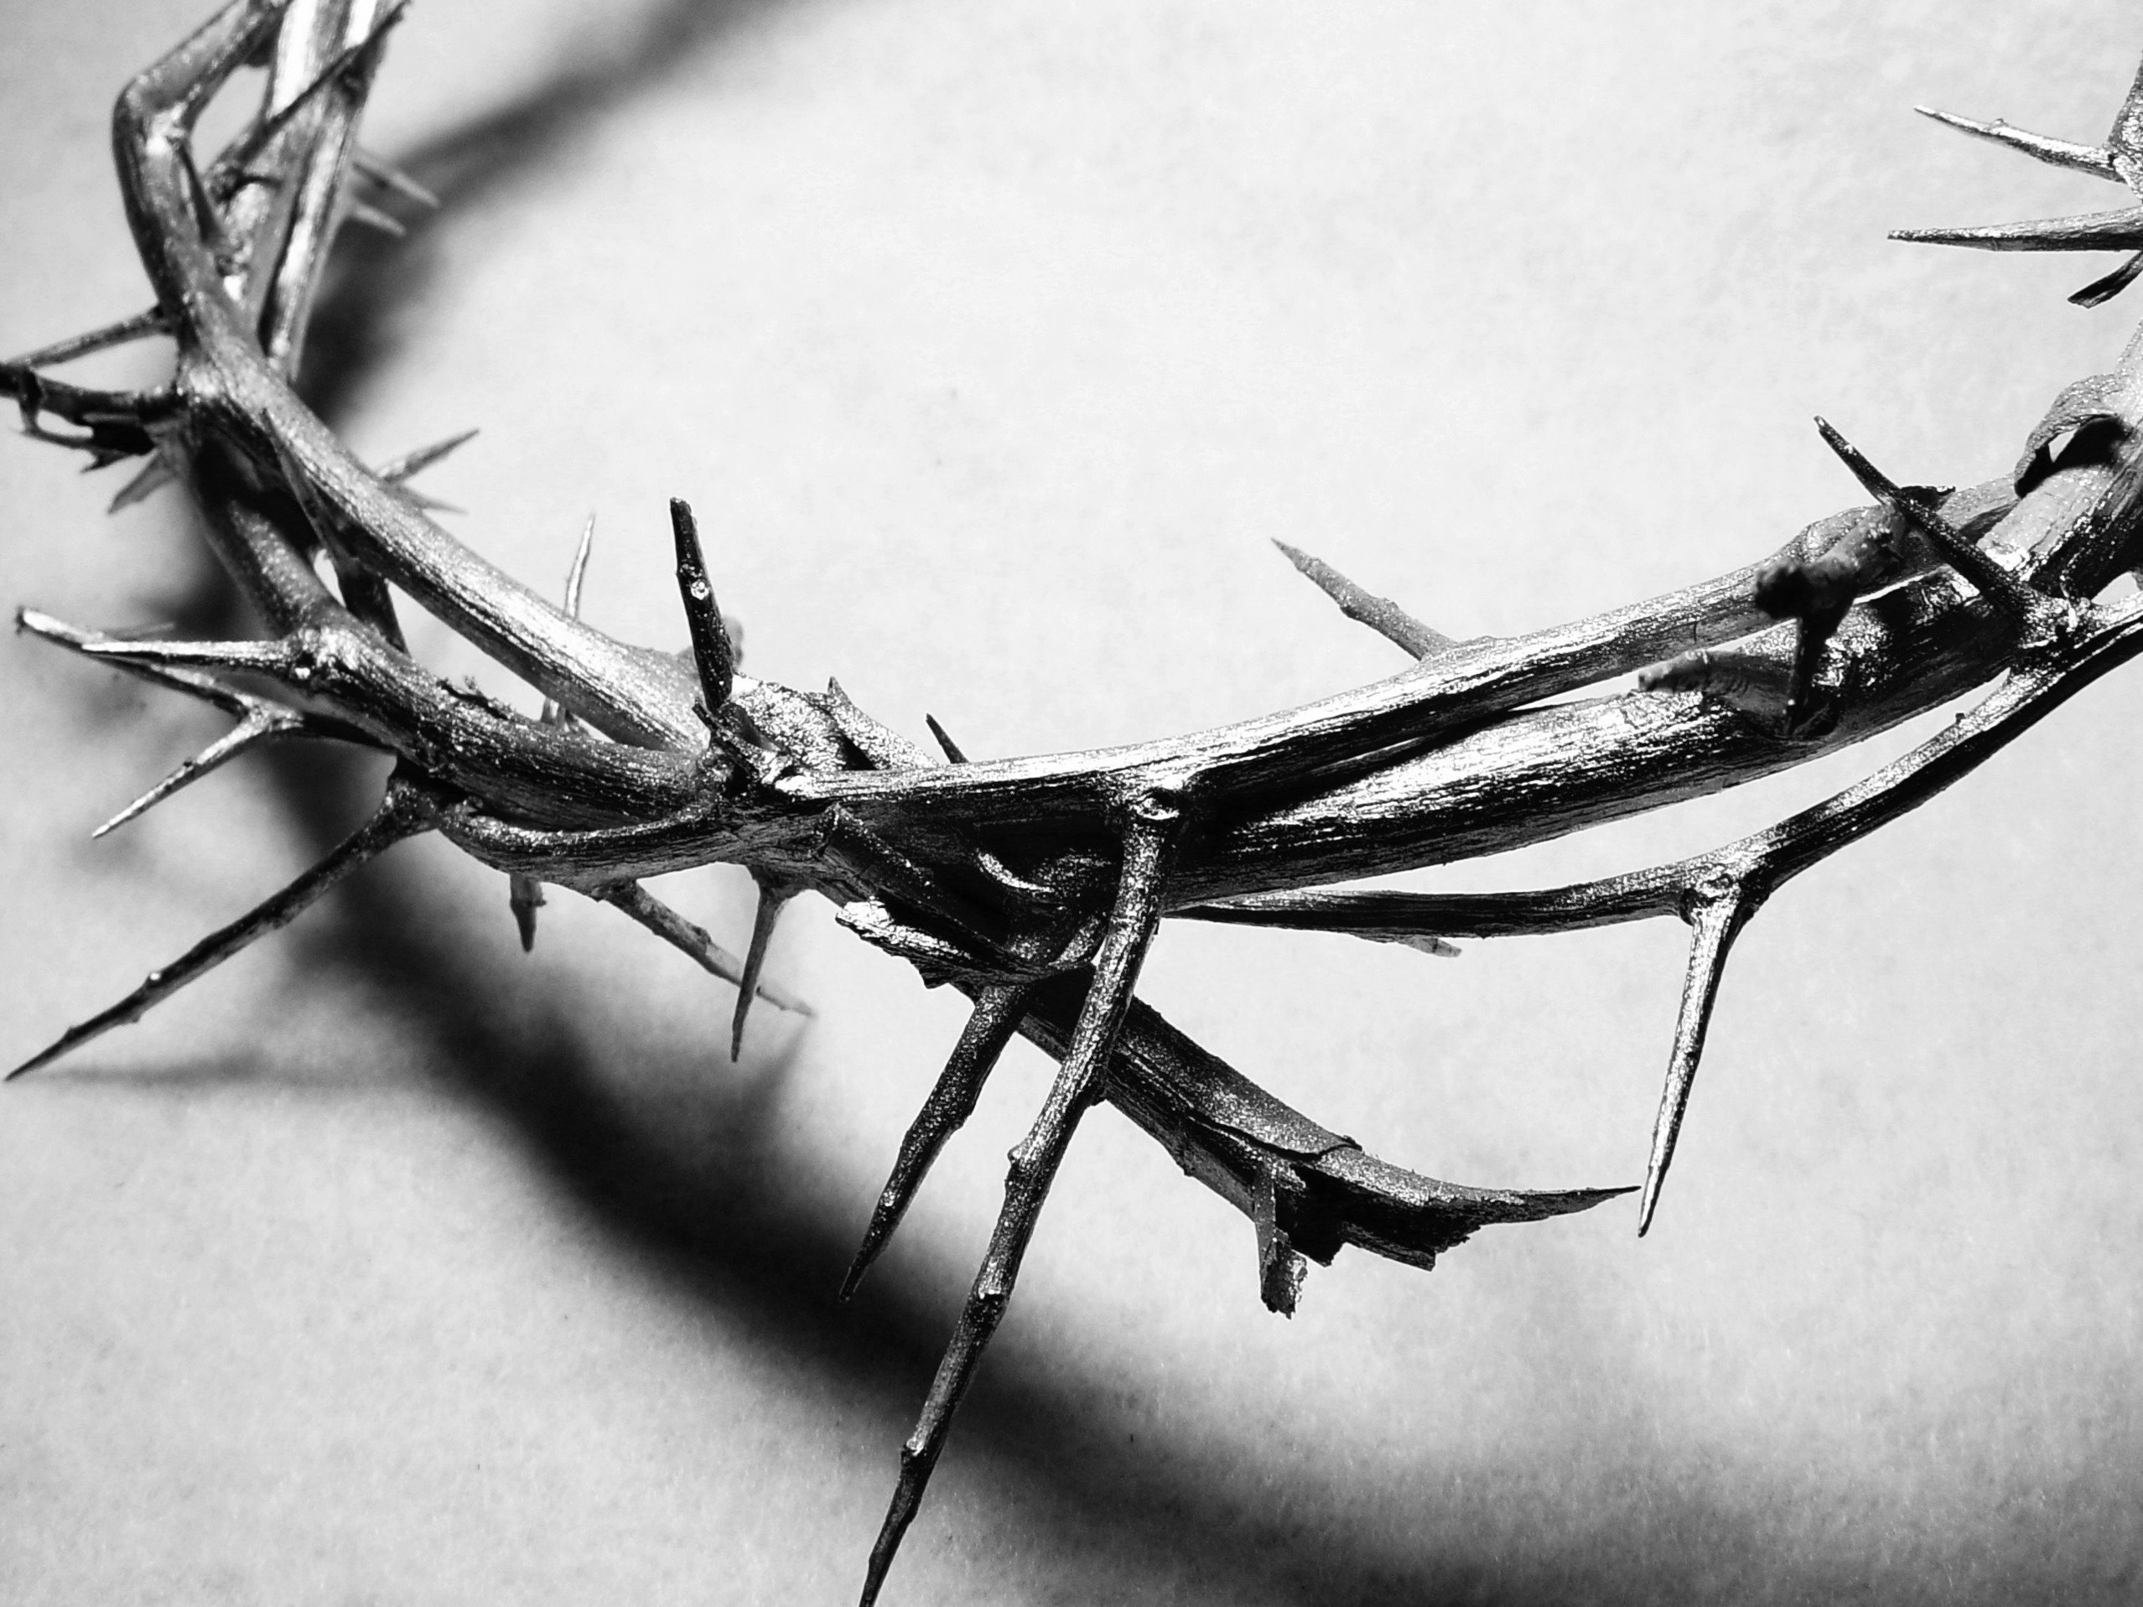
The Last Year

Slide 2
Matthew 23:1-3
Then Jesus said to the crowds and to his disciples, 2 “The teachers of religious law and the Pharisees are the official interpreters of the law of Moses. 3 So practice and obey whatever they tell you, but don’t follow their example. For they don’t practice what they teach.

Slide 3
Practice and obey what they tell you
What Moses told you is valid
The “Law” is God’s word; and that means that we are to not just listen to it, but live by it!
Don’t follow the example of those who are teaching that law to you!
What is about to follow is a list of reasons why you shouldn’t be like the teachers of the law!

Slide 4
Matthew 23:4-7
They crush people with unbearable religious demands and never lift a finger to ease the burden. 5 “Everything they do is for show. On their arms they wear extra wide prayer boxes with Scripture verses inside, and they wear robes with extra long tassels. 6 And they love to sit at the head table at banquets and in the seats of honor in the synagogues. 7 They love to receive respectful greetings as they walk in the marketplaces, and to be called ‘Rabbi.’

Slide 5
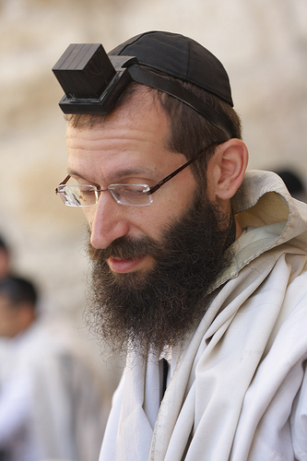
They crush people
They add things to the law!
They didn’t follow their own teachings!
Everything that they do is for show
Prayer boxes - Phylactery

Slide 6
They crush people
They add things to the law!
They didn’t follow their own teachings!
Everything that they do is for show
Prayer boxes - Phylactery
Fringe on their robes
Best places to sit
Being called Rabbi

Slide 7
Matthew 23:8-10
“Don’t let anyone call you ‘Rabbi,’ for you have only one teacher, and all of you are equal as brothers and sisters. 9 And don’t address anyone here on earth as ‘Father,’ for only God in heaven is your spiritual Father. 10 And don’t let anyone call you ‘Teacher,’ for you have only one teacher, the Messiah.

Slide 8
The truth about titles…
Who do we build up more?
Is everything supposed to be about us?
Isn’t it supposed to be about Jesus?
Don’t address anyone here on earth as Father!
Does this mean we can’t call our dad’s father?
We cannot think of people as the “father of our faith”
Cannot think of one person as better than us…

Slide 9
Matthew 23:11-12
The greatest among you must be a servant. 12 But those who exalt themselves will be humbled, and those who humble themselves will be exalted.

Slide 10
What is required of us to really succeed?
We must be a servant!
We must get to the point that life is really about Jesus, and not what we want!
We must humble ourselves!
Putting God’s will and word above our will and word!

Slide 11
Some questions that we need to ask today
Do we think that we are better than other people?
Do we really have to be a servant?
Do we have the heart and attitude of a servant?
Are we really humble?
How do we humble ourselves?
By living to please God and not ourselves!
Are we living by that strandard?

