Slide 1
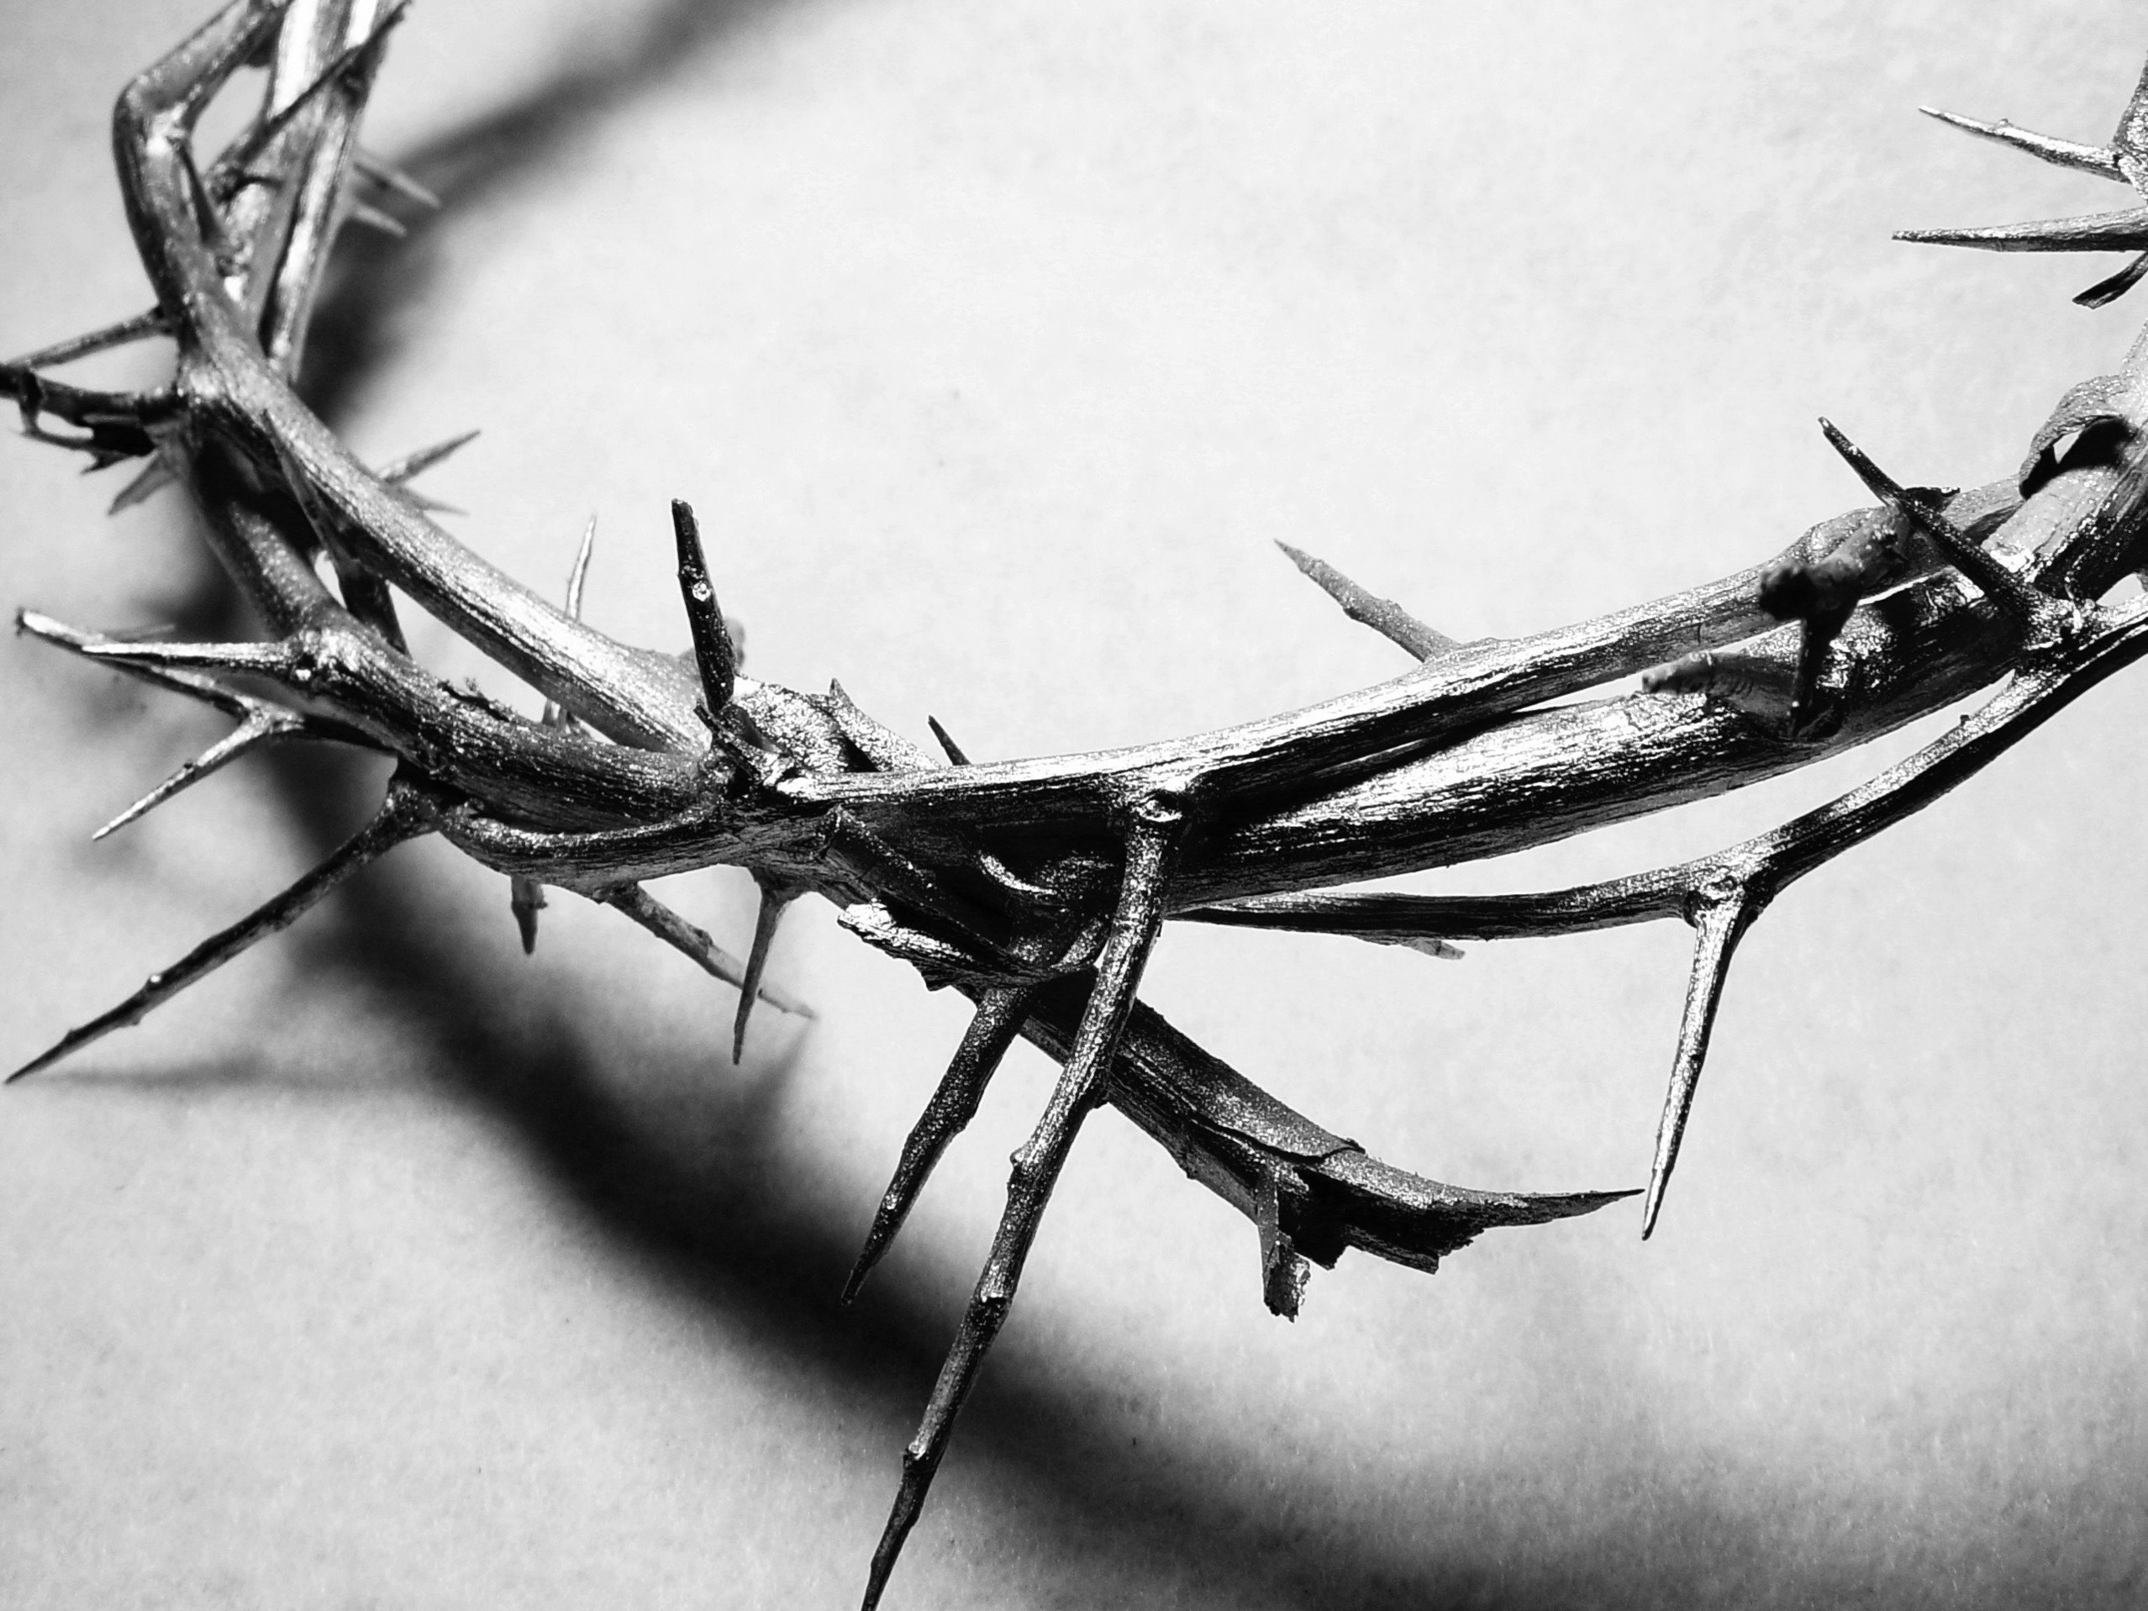
The Last Year

Slide 2
Matthew 19:30
But many who are the greatest now will be least important then, and those who seem least important now will be the greatest then.

Slide 3
Matthew 20:1-2
“For the Kingdom of Heaven is like the landowner who went out early one morning to hire workers for his vineyard. 2 He agreed to pay the normal daily wage and sent them out to work.”

Slide 4
The Kingdom of Heaven is like…
A Landowner
Jesus loved to use this in reference to Himself.
The one who posses power and authority – it’s His property.
The Vineyard
Typically represented as Israel in O.T.
In N.T. it’s represented by the whole world

Slide 5
The Kingdom of Heaven is like…
Workers
Those who respond to the landowner
They have a guarantee of something to come at the end of the day
Pay the normal wage
What was set as a reward for their labor
They were told in advance what they would receive

Slide 6
The Kingdom of Heaven is like…
He sent them out to work
They now were working for the landowner in his vineyard!
Everything that they were doing was on the landowner’s behalf!
They were involved in bring in the crop!

Slide 7
Matthew 20:3-5
“At nine o’clock in the morning he was passing through the marketplace and saw some people standing around doing nothing. 4 So he hired them, telling them he would pay them whatever was right at the end of the day. 5 So they went to work in the vineyard. At noon and again at three o’clock he did the same thing.

Slide 8
The time frame being talked about
The first group at 6:00 am
The next group at 9:00am
Then Noon
Then 3:00 pm
The landowner wants as big of a harvest as possible!

Slide 9
Matthew 20:6-7
“At five o’clock that afternoon he was in town again and saw some more people standing around. He asked them, ‘Why haven’t you been working today?’ 7 “They replied, ‘Because no one hired us.’ “The landowner told them, ‘Then go out and join the others in my vineyard.’

Slide 10
With only one hour left…
At 5:00pm
He still wants to affect the harvest!
Why haven’t you been working today?
No one asked us
Go join the others

Slide 11
Matthew 20:8-10
“That evening he told the foreman to call the workers in and pay them, beginning with the last workers first. 9 When those hired at five o’clock were paid, each received a full day’s wage. 10 When those hired first came to get their pay, they assumed they would receive more. But they, too, were paid a day’s wage.

Slide 12
Wrong verses right expectations
Those working for one hour…
The first group thought they would get more..
Do we think we deserve more than someone else?
In the Kingdom of Heaven, everyone gets the same reward!

Slide 13
Matthew 20:11-12
When they received their pay, they protested to the owner, 12 ‘Those people worked only one hour, and yet you’ve paid them just as much as you paid us who worked all day in the scorching heat.’

Slide 14
A matter of the heart
Not a matter of who worked more
Not a matter of who accomplished more
A wrong heart will think it deserves more than someone else!
What’s really important is that someone responds to the landowner!

Slide 15
Matthew 20:13-16
“He answered one of them, ‘Friend, I haven’t been unfair! Didn’t you agree to work all day for the usual wage? 14 Take your money and go. I wanted to pay this last worker the same as you. 15 Is it against the law for me to do what I want with my money? Should you be jealous because I am kind to others?’ 16 “So those who are last now will be first then, and those who are first will be last.”

Slide 16
Don’t be jealous!
Speaks to what we think about ourselves
Do we compare ourselves to the other people working in the vineyard?
Do we elevate ourselves above other people?
Speaks to what we really think about someone else
It shows what is happening in our hearts!

Slide 17
Those who are last now will be first then, and those who are first will be last
In Heaven we will all be equal!

Slide 18
Are we really alright with anyone finding Jesus?
Jealously
Prejudice
Self-righteousness

Slide 19
Are we happy that other people come to know Jesus?
Do we welcome them?
Are we truly excited to help someone find Jesus?

Slide 20
Are we really working in His vineyard?
Are we actually bringing other people to Jesus, or are we just trying to make it there ourselves?
We cannot forget that Jesus wants a harvest!

