Slide 1
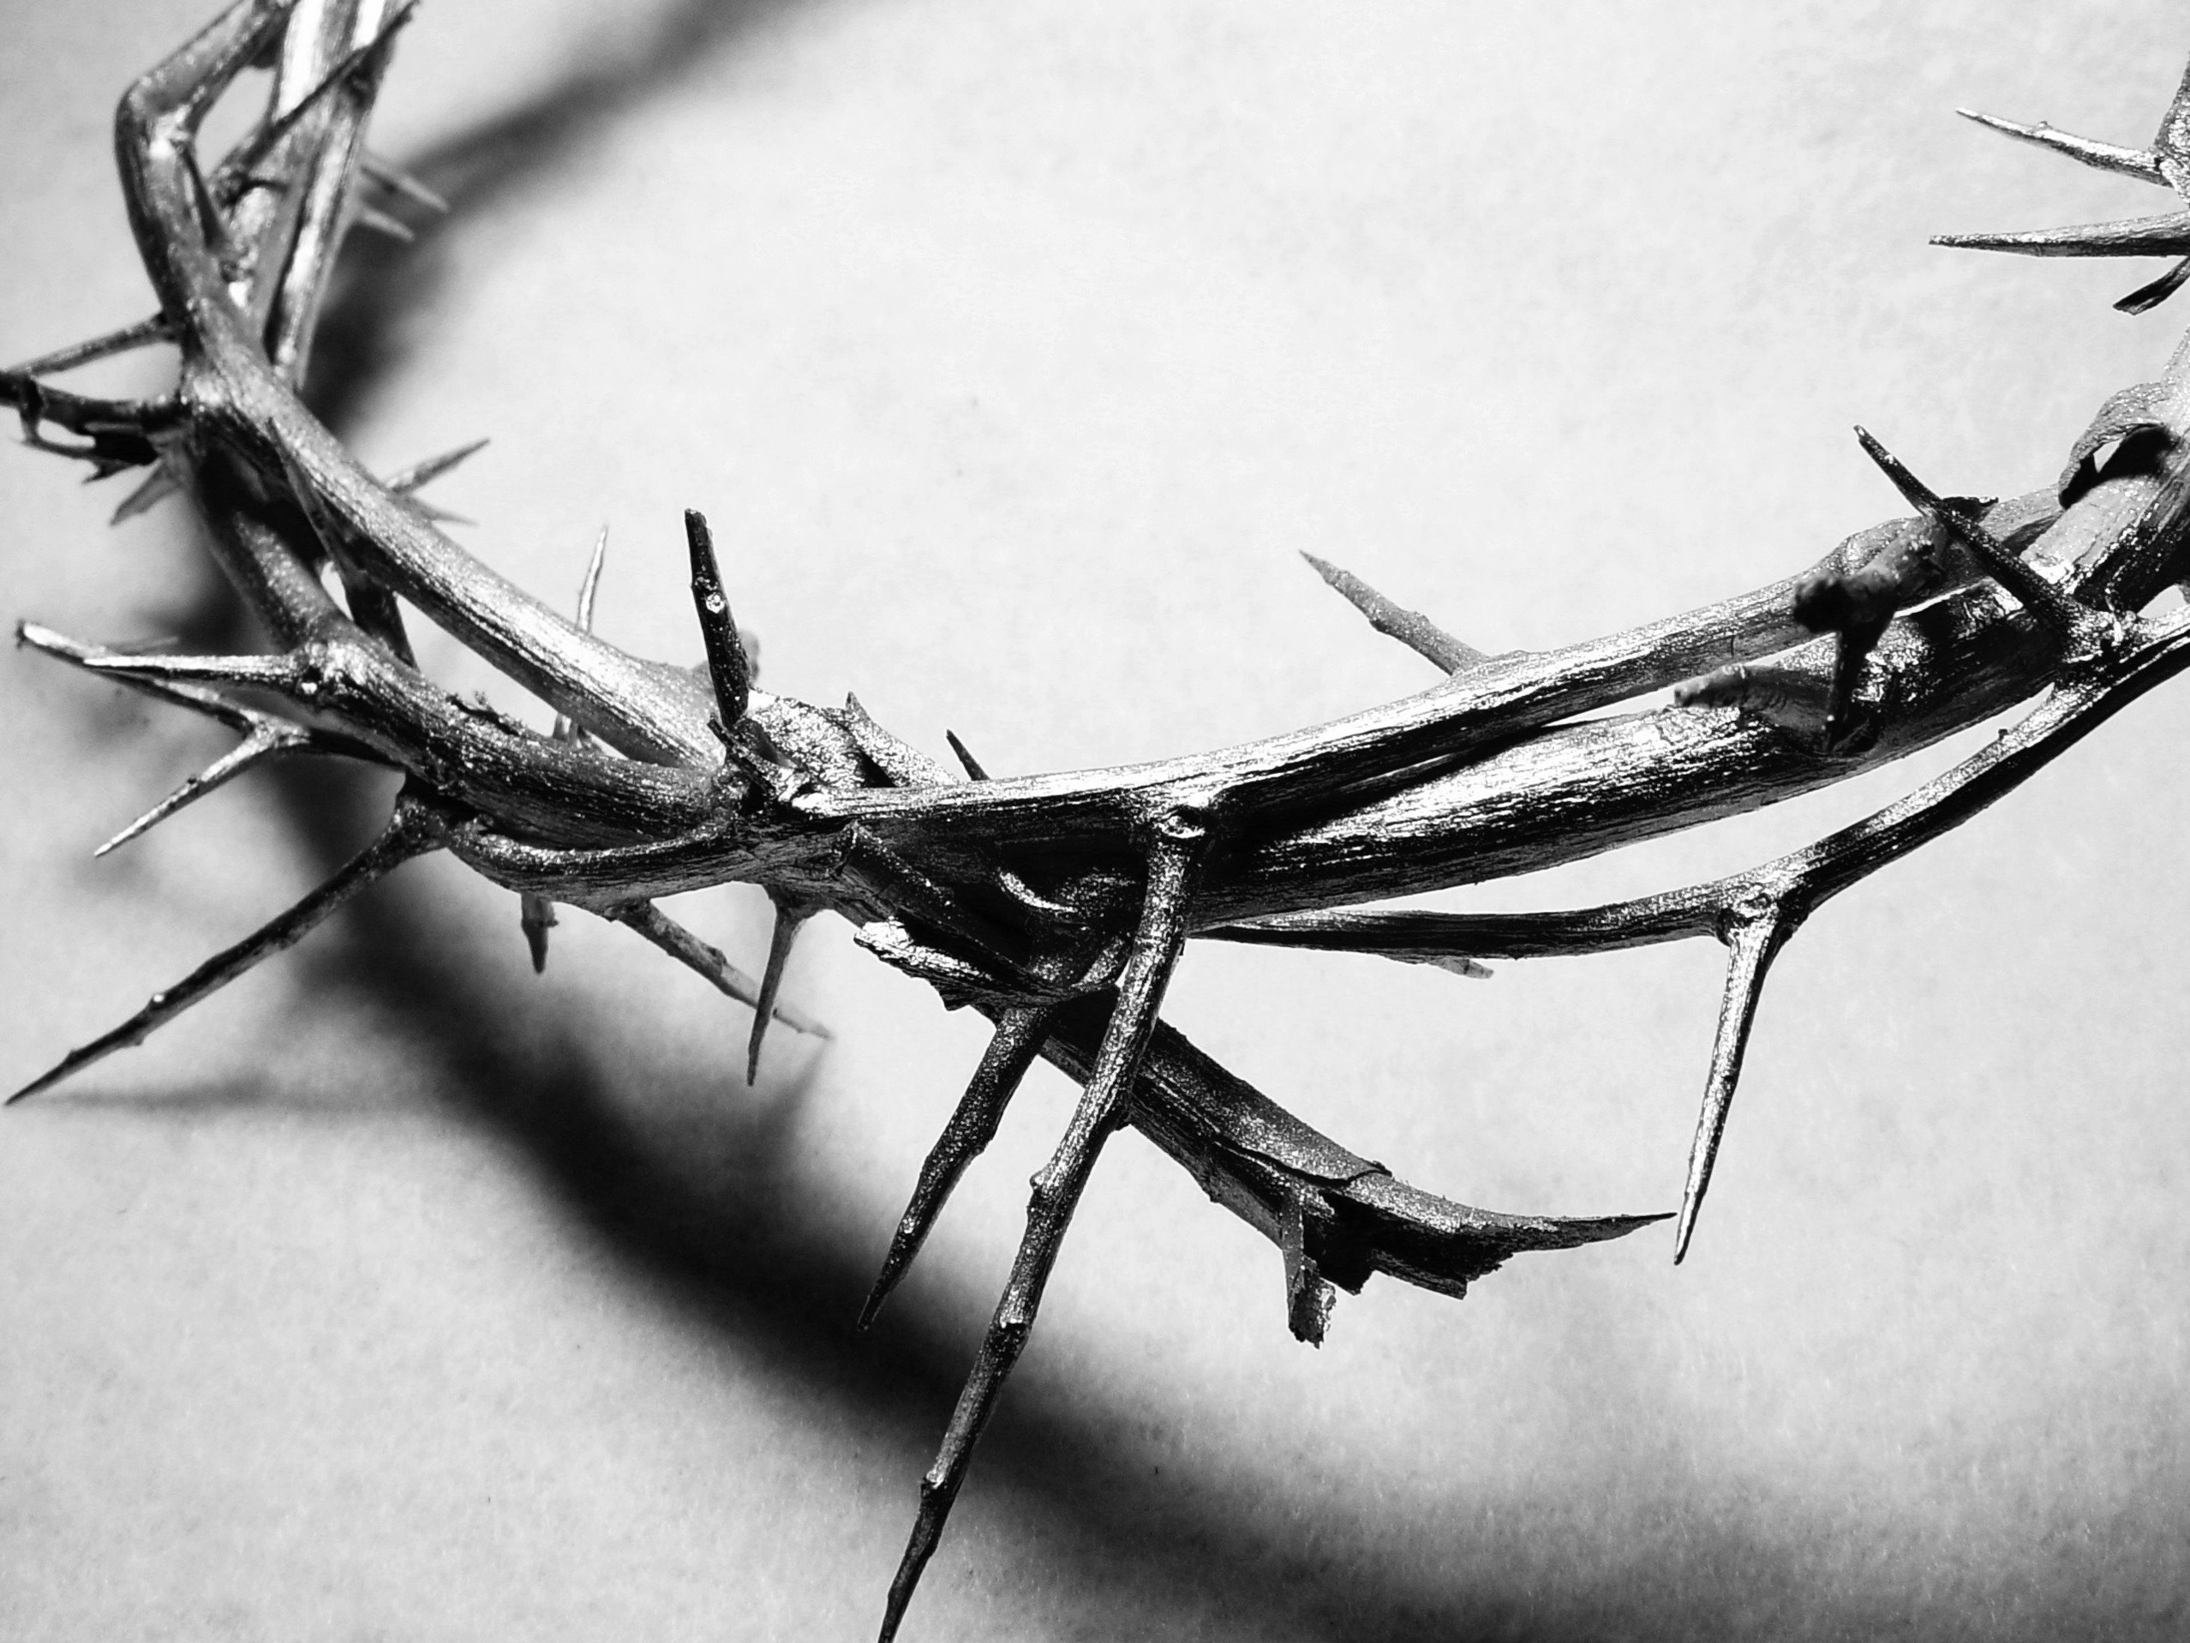
The Last Year

Slide 2
Matthew 19:16
Someone came to Jesus with this question: “Teacher, what good deed must I do to have eternal life?”

Slide 3
What good deed must I do to have eternal life?
What good deed?
What do I have to do?
The teaching of the time…
What you do earns your acceptance

Slide 4
Matthew 19:17
“Why ask me about what is good?” Jesus replied. “There is only One who is good. But to answer your question—if you want to receive eternal life, keep the commandments.”

Slide 5
If you want to be saved, don’t do – keep!
What is good…
There is only one who is good!
Authority
Keeping not doing
A matter of the heart, not the hand
Obeying not accomplishing
Out of love, not obligation

Slide 6
Matthew 19:18-19
“Which ones?” the man asked. And Jesus replied: “‘You must not murder. You must not commit adultery. You must not steal. You must not testify falsely. 19 Honor your father and mother. Love your neighbor as yourself.’ ”

Slide 7
Jesus quotes the commandments that deal with how we live in this world
Our hearts will show what is going on inside of it to the world!

Slide 8
Matthew 19:20
“I’ve obeyed all these commandments,” the young man replied. “What else must I do?”

Slide 9
Matthew 19:21
Jesus told him, “If you want to be perfect, go and sell all your possessions and give the money to the poor, and you will have treasure in heaven. Then come, follow me.”

Slide 10
If you want to be perfect?
Complete in all of its parts
Since he wasn’t complete, something was missing from his life!
God wants to make us complete
He want’s us to grow and become who He created us to be
We have to understand that we are not “perfect” yet!

Slide 11
Sell all you have and give to the poor
What was this man lacking – what was he not complete in?
He loved something more than God!
He trusted in what he had, instead of trusting in God
What did he love more?

Slide 12
Come, follow Me
The same as the 12?
What did he give up in walking away?

Slide 13
Matthew 19:22-24
But when the young man heard this, he went away sad, for he had many possessions. 23 Then Jesus said to his disciples, “I tell you the truth, it is very hard for a rich person to enter the Kingdom of Heaven. 24 I’ll say it again—it is easier for a camel to go through the eye of a needle than for a rich person to enter the Kingdom of God!”

Slide 14
Why is it impossible?
Because of what our hearts trust!
Do our hearts trust in what we have?
Do our hearts trust what God has done for us?
Do we really live like we trust God over our finances?

Slide 15
Matthew 19:25-26
The disciples were astounded. “Then who in the world can be saved?” they asked. 26 Jesus looked at them intently and said, “Humanly speaking, it is impossible. But with God everything is possible.”

Slide 16
If it was left up to men, no one would be saved!
Who in the world can be saved?
Jesus looked at their hearts – and there was a difference!
With God everything is possible!
Jesus made a way for us to be saved!
We have to accept His grace!

Slide 17
Matthew 19:27
Then Peter said to him, “We’ve given up everything to follow you. What will we get?”

Slide 18
We’ve done this, right?
Do our hearts trust God, or do they trust what we have?

Slide 19
Matthew 19:28-29
Jesus replied, “I assure you that when the world is made new and the Son of Man sits upon his glorious throne, you who have been my followers will also sit on twelve thrones, judging the twelve tribes of Israel. 29 And everyone who has given up houses or brothers or sisters or father or mother or children or property, for my sake, will receive a hundred times as much in return and will inherit eternal life.

Slide 20
If we give up this world and everything in it…
We will gain the world that is to come!

Slide 21
Matthew 19:30
But many who are the greatest now will be least important then, and those who seem least important now will be the greatest then.

Slide 22
What are we doing?
Do we do, or do we keep His commands
It’s not what we do; it’s what He has done for us!
To gain eternal life we have to trust the grace and love of Jesus!
We have to have a heart that gives everything to Jesus!
There must not be one part of us that we think we deserved or earned!

