Slide 1
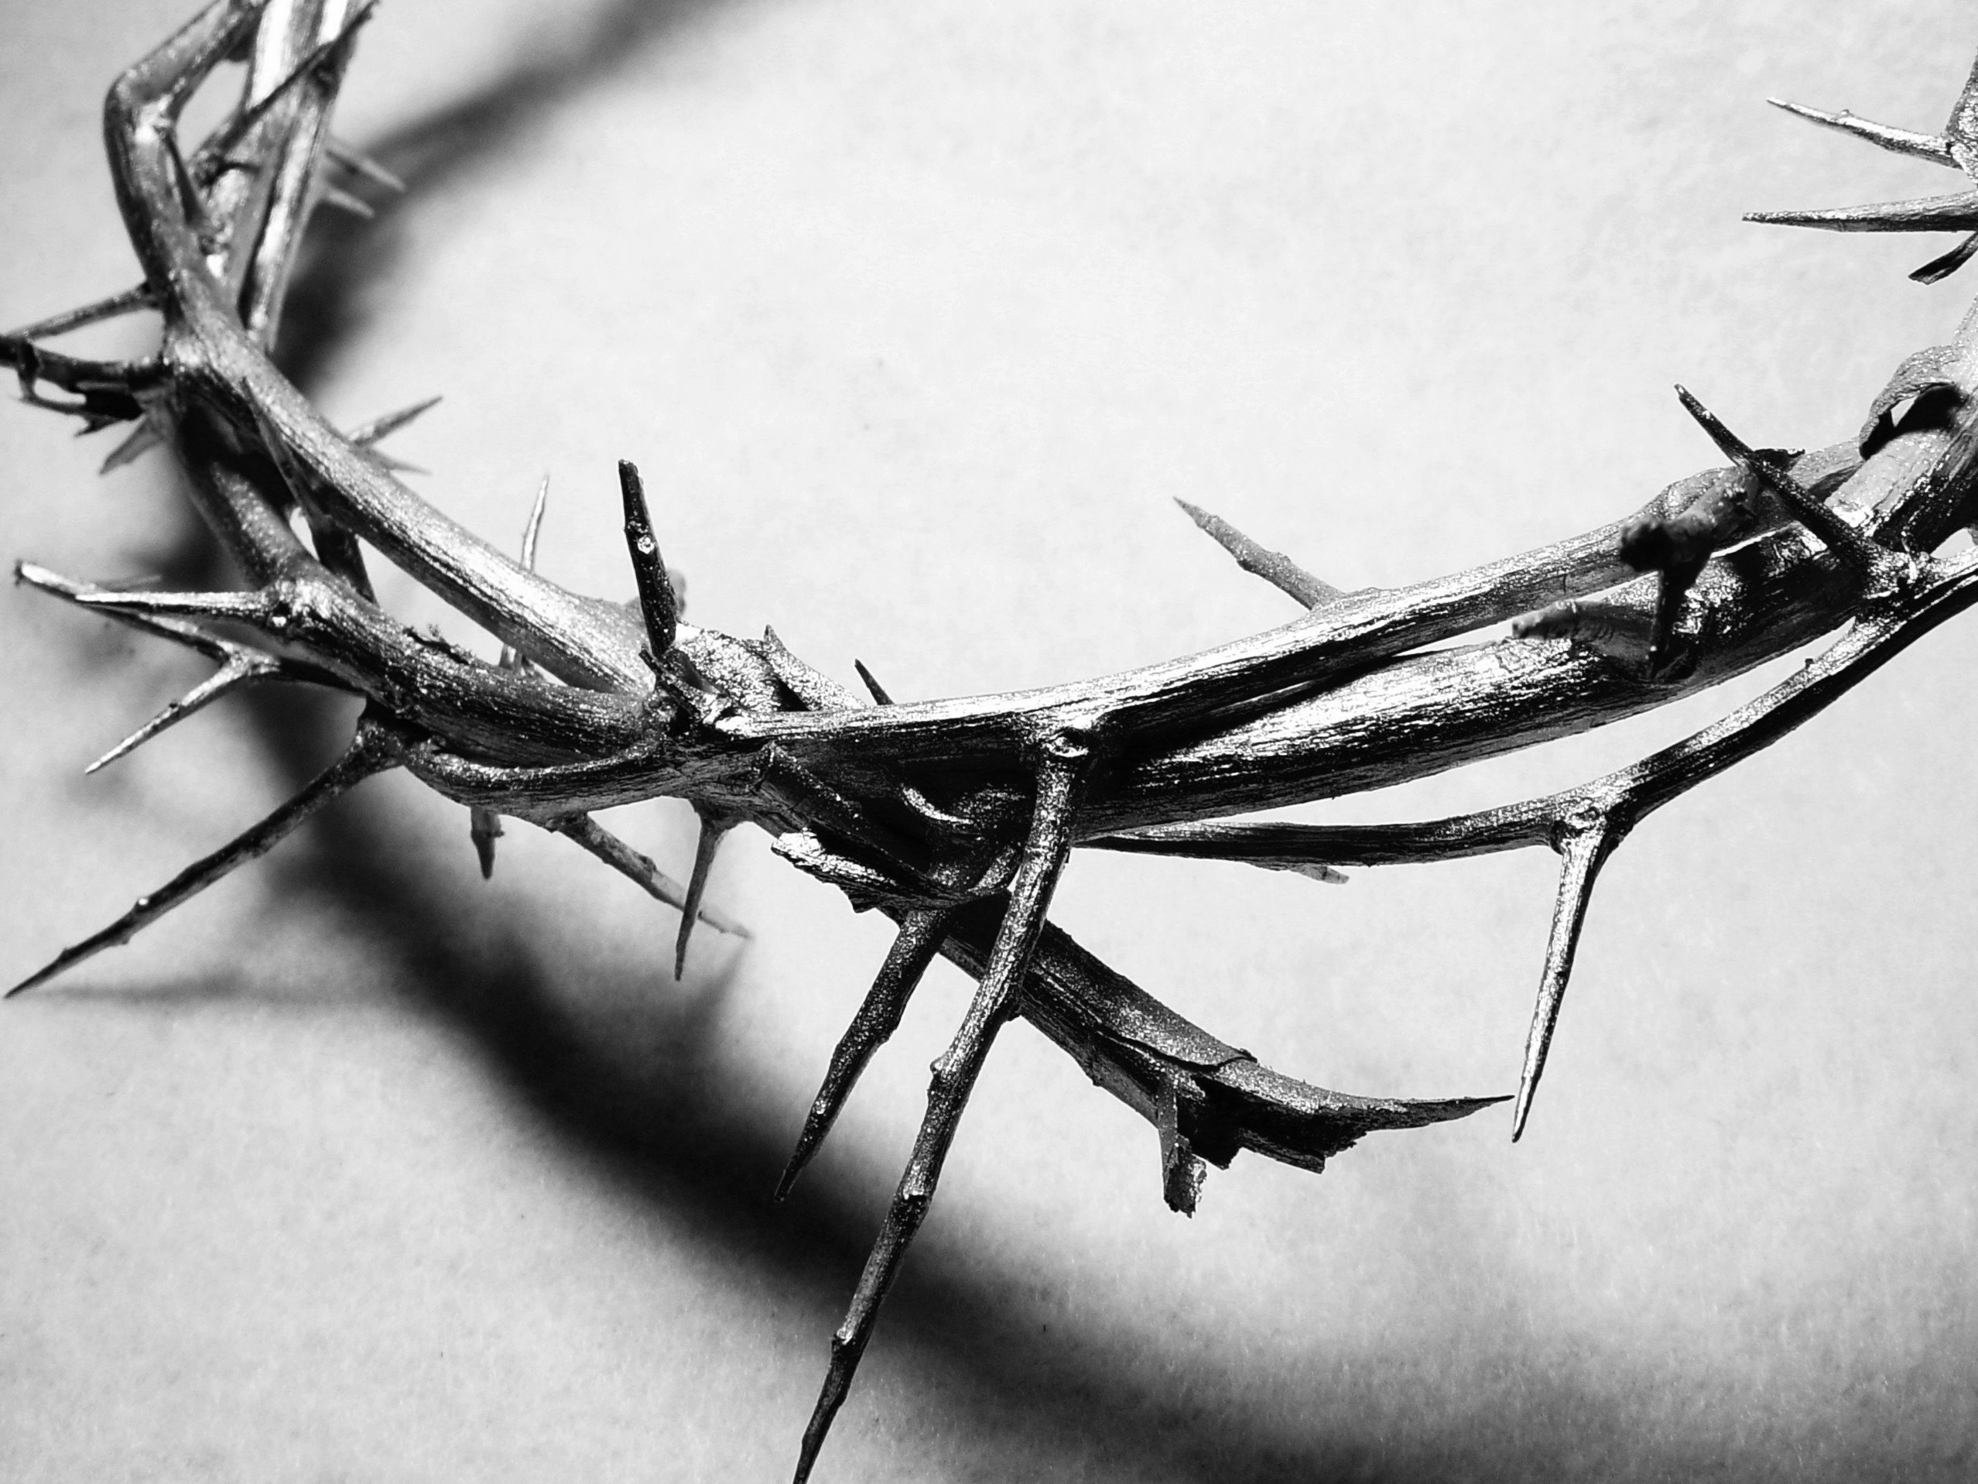
The Last Year

Slide 2
John 11:1-3
A man named Lazarus was sick. He lived in Bethany with his sisters, Mary and Martha. 2 This is the Mary who later poured the expensive perfume on the Lord’s feet and wiped them with her hair. Her brother, Lazarus, was sick. 3 So the two sisters sent a message to Jesus telling him, “Lord, your dear friend is very sick.”

Slide 3
Lazarus, Mary, and Martha
Bethany
Mary will have a big role soon
Lazarus was sick
Mary and Martha sent a message to Jesus
Your friend is very sick
He’s not just sick, he’s sick; and needs a miracle!

Slide 4
Can the people that God loves and cares for experience sickness?
Yes
Sickness and death is part of this world because of sin
All of us will experience it

Slide 5
John 11:4-6
But when Jesus heard about it he said, “Lazarus’s sickness will not end in death. No, it happened for the glory of God so that the Son of God will receive glory from this.” 5 So although Jesus loved Martha, Mary, and Lazarus, 6 he stayed where he was for the next two days.

Slide 6
Lazarus’s sickness will not end in death!
It is not random
It has a purpose
For the glory of God
For the Son of God to receive glory
This event is for something bigger!

Slide 7
Jesus loved them, and didn’t come!
Are we okay with God loving us so much that He doesn’t do something for us?
Are we okay with God allowing us to go through something very hard to have something better happen?

Slide 8
John 11:7-10
Finally, he said to his disciples, “Let’s go back to Judea.” 8 But his disciples objected. “Rabbi,” they said, “only a few days ago the people in Judea were trying to stone you. Are you going there again?” 9 Jesus replied, “There are twelve hours of daylight every day. During the day people can walk safely. They can see because they have the light of this world. 10 But at night there is danger of stumbling because they have no light.”

Slide 9
We have to go to crush the darkness with light
The war between darkness and light
Don’t fear anything that can take your life!
Know that God will always work all things out for good…

Slide 10
John 11:11-15
Then he said, “Our friend Lazarus has fallen asleep, but now I will go and wake him up.” 12 The disciples said, “Lord, if he is sleeping, he will soon get better!” 13 They thought Jesus meant Lazarus was simply sleeping, but Jesus meant Lazarus had died. 14 So he told them plainly, “Lazarus is dead. 15 And for your sakes, I’m glad I wasn’t there, for now you will really believe. Come, let’s go see him.”

Slide 11
Now I will go and wake him up
He was asleep - right?
He’s dead!
It was for them?
So that they could believe?

Slide 12
John 11:16
Thomas, nicknamed the Twin, said to his fellow disciples, “Let’s go, too—and die with Jesus.”

Slide 13
Did the disciples know and understand what Jesus was doing?
Did they follow Jesus anyway?

Slide 14
What do we do when we don’t understand what God is doing?
Do we walk away, or do we follow?
Do we doubt, or do we believe?
Do we give in, or do we give God everything?

